Slide 1
Language Translator
Steven

Slide 2
Tokenizing
Chinese characters mean different things alone and when together (phrases)
馬來西亞
加拿大
Malaysia
Canada
Horse
Come
West
Asia
Plus
Take
Big

Slide 3
Process Flow
I came to Beijing Tsinghua University
我来到北京清华大学
I
Came
To
Beijing
Tsinghua
University
1
2
3
4
5
6
Deep Learning Model
1
2
3
4
我
来到
北京
清华大学

Slide 4
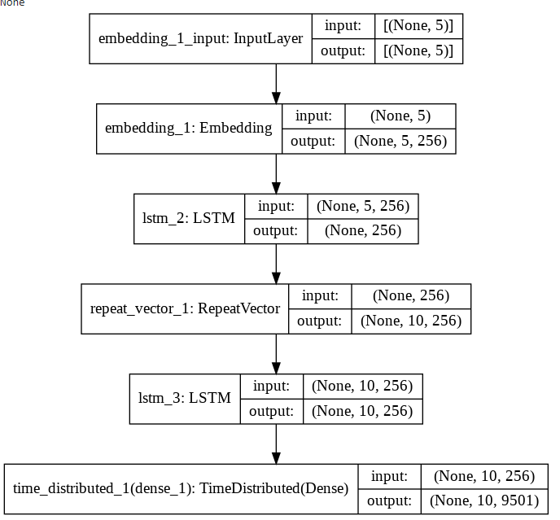
Model Overview

Slide 5









Translations
Canada
Weather
Red
Weather
Window
Hong Kong
Concrete Mixing Truck
You can download

Slide 6
Lessons Learned
Chinese needs a more complex machine learning model to get accurate translations
Language translations in general need a large amount of data and lots of time to train
Probably need some better preprocessing to accommodate for the intricacies of the Chinese language. (better phrase splitting)

